Slide 1
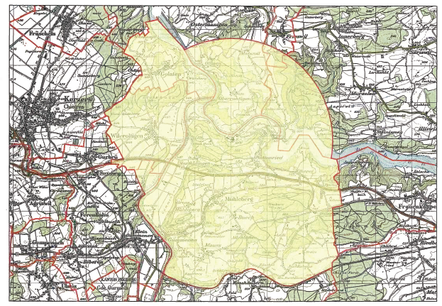
Zone 1 KKM

